Slide 1


Computational Journalism – Some Aspects
Niloy Ganguly
IIT Kharagpur, India
Complex Network Research Group (CNeRG)
http://cnerg.org @cnerg
facebook.com/iitkgpcnerg/

Slide 2
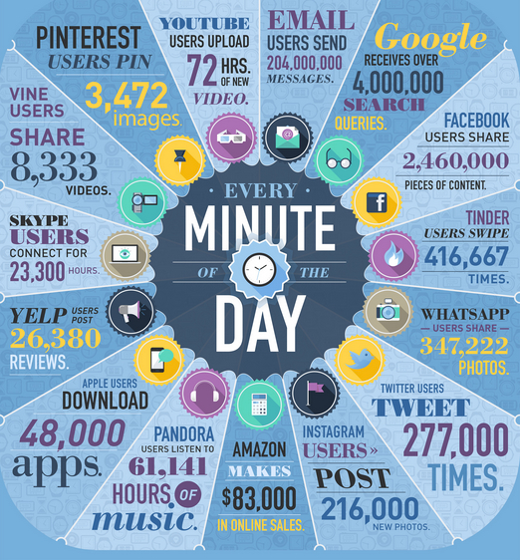
Explosive growth in online contents

Slide 3
Need for Recommendation Systems
Websites today produce way more information than any user can consume
e.g., 750 - 800 news stories get added every day to news media site nytimes.com
Users need to rely on Information Retrieval (content recommendation, search, or ranking) systems to find important information.

Slide 4

Huge change in news landscape

Slide 5
Competition for user attention
Lots of news media sites are competing for user attention.
The sites are predominantly dependent on the advertisements seen by the users.

Slide 6
Focus of this talk
1. Are different recommendation systems deployed on media sites creating coverage bias?
2. How are the media sites competing with each other to bait users to click on their article links?
3. Do crowd sourced recommendations like Trending topics are mostly biased towards particular demographic groups?

Slide 7


Can Recommendations Create Coverage Bias? Understanding the Filtering Effects of Online News Recommendations
Niloy Ganguly
joint work with
Abhijnan Chakraborty, Saptarshi Ghosh, and Krishna P. Gummadi
ICWSM 2016

Slide 8
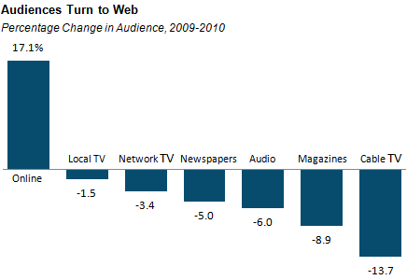
Offline news readership in decline
while online is increasing
Source: Nielsen Media Research, Pew Research Center and
Audit Bureau of Circulations. 2010.

Slide 9
The Problem
As news consumption moves online, users face a bewildering array of recommendations from a variety of sources and time-scales

Slide 10
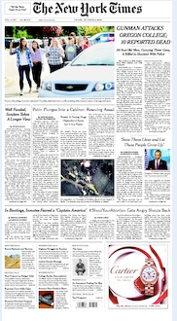
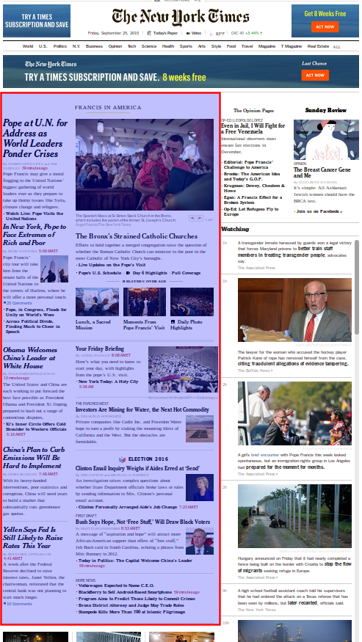
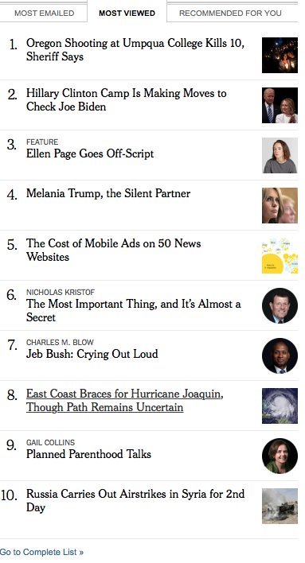
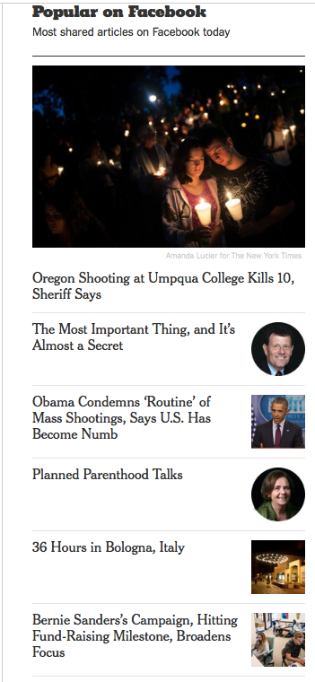
Recommendations on nytimes.com
From a variety of sources: individuals, experts, crowds, personalization algorithms

Slide 11
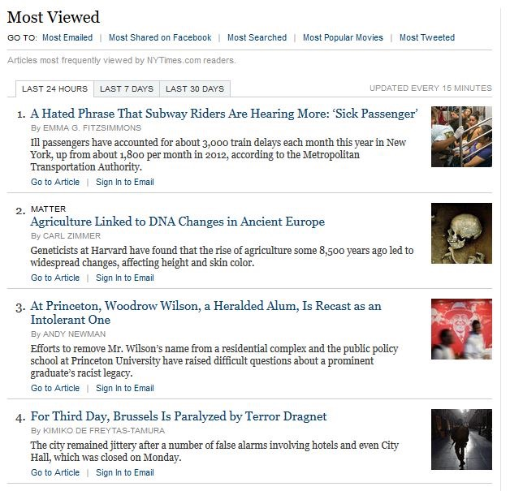
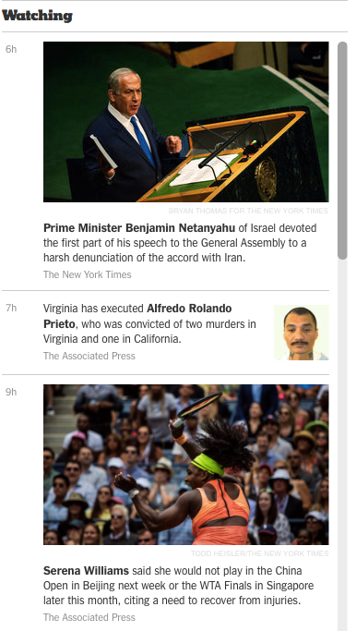
Recommendations over time-scales
Daily Popular
Weekly Popular
Popular
Over a Month

Slide 12
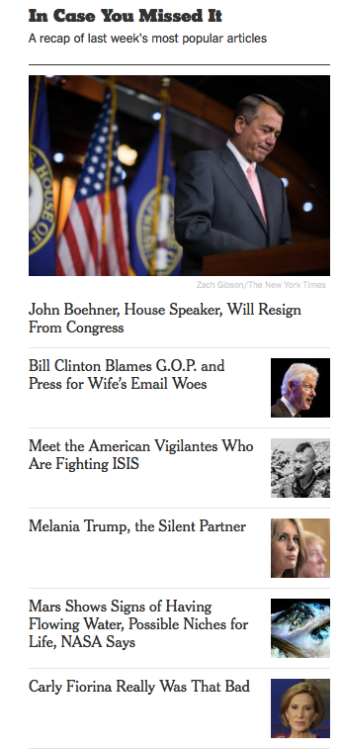
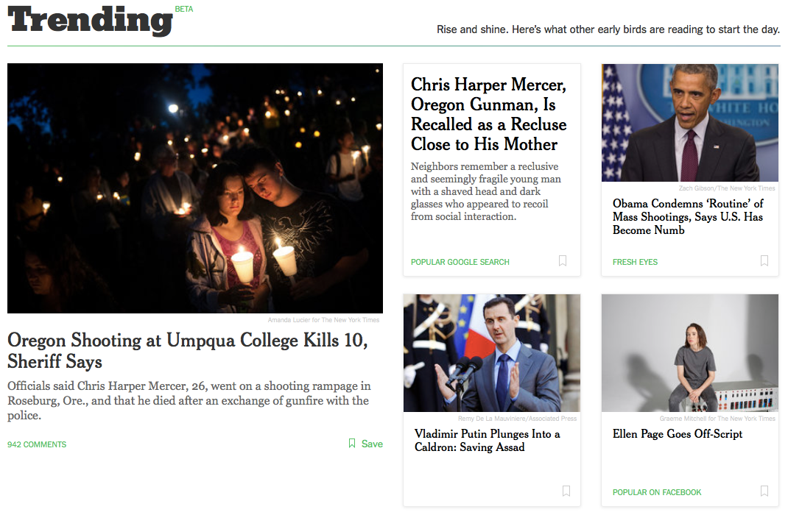
Recommendations over time-scales

Slide 13
High-level Question
Do the different types of recommendations introduce
different types of coverage biases?

Slide 14
Media Bias
Classification by D’Alessio et al. [Journal of comm.’00]
Gatekeeping or Selection Bias
Coverage Bias
Statement or Structural Bias
Classification by McQuail [Sage’92]
Partisanship: An open and intended bias
Propaganda: A hidden but intended bias
Unwitting Bias: An open but unintentional bias
Ideology: A hidden as well as unintended bias
Notes:
Selection bias or gatekeeping. In partisan politics, the preference for selecting stories from one party. We observe selection bias by determining which media/community covers a certain story or person. Coverage bias. In partisan politics, the preference for giving a larger amount of coverage (time/space) to stories about one party. We observe coverage bias by looking at the amount of attention each story or person is given. Statement bias. In partisan politics, the preference for expressing more favorable (or more disfavorable) statements for one party. We observe statement bias by looking at the sentiments in statements mentioning different people.

Slide 15
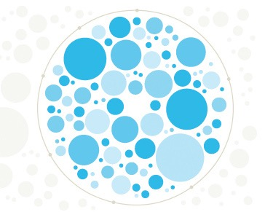
Personalization and Filter Bubble
Users get recommendations based on past click behaviors, search histories.
Can gradually become separated from the type of information that diverts from their past behavior.
Eventual isolation in their own cultural or ideological bubbles.
Pariser [Penguin’11]
Flaxman et al. [Public Opinion Qly’16]

Slide 16
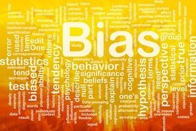
Coverage Bias
Similar to Filter Bubble, but more subtle.
Can go undetected if analyzed on individual instances.
Can occur in non-personalized setting as well.

Slide 17
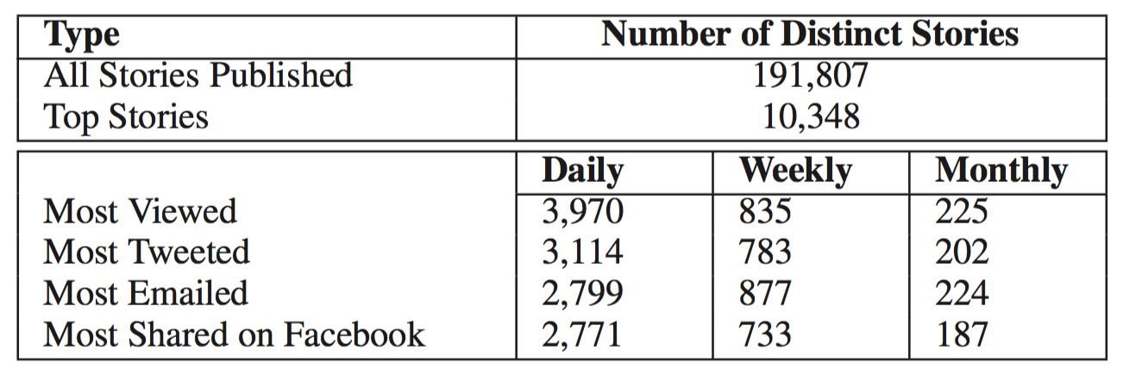
Datasets analyzed
Collected news stories from NYTimes
during July, 2015 – February, 2016

Slide 18
How should we measure bias?
Coverage of news
Sectional coverage
Topical coverage
Coverage of hard vs. soft news
To measure bias, compare news coverage of recommended stories.

Slide 19
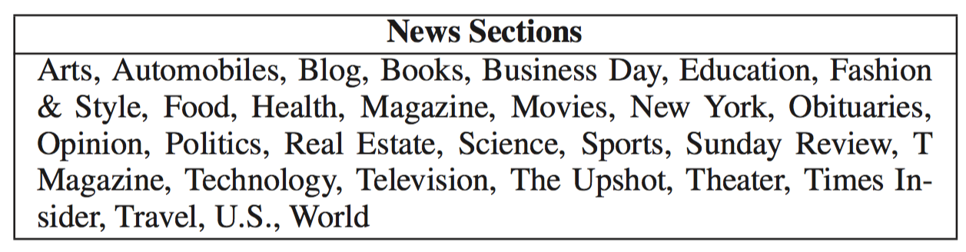
Sectional coverage of news stories
Sectional Coverage: Distribution of stories over different news sections.

Slide 20
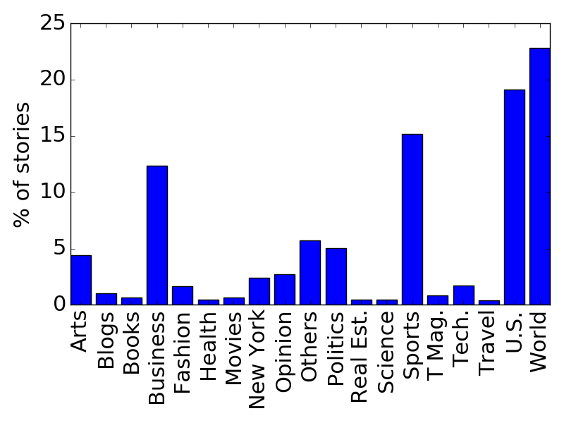
Sectional coverage of news stories
Sectional coverage of all stories published at
NYTimes during July, 2015 – February, 2016

Slide 21
Topical coverage of news stories
Topics: Keywords describing the focus of a news story.
5 topics per NYTimes story
Combination of manual and algorithmic techniques to assign topics
Topical coverage: frequency distribution over all topics covered in a collection of stories

Slide 22
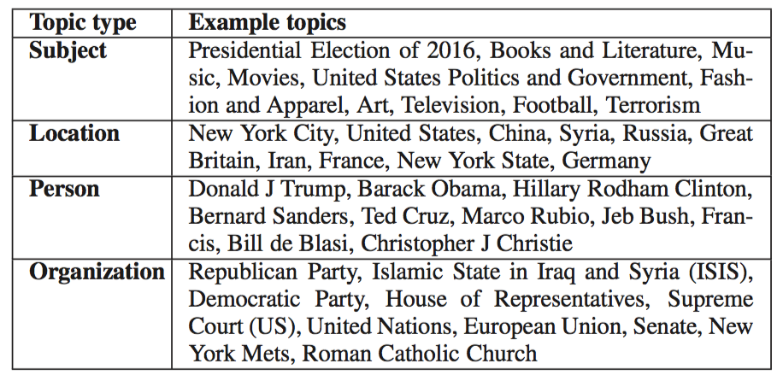
Most frequent topics

Slide 23
Coverage of hard vs. soft news
Lack of clear operational distinction.
Hard news: urgent or breaking events involving top leaders, major issues, or significant disruptions in the daily lives of citizens.
Soft news: human interest stories, less time bound and more personality centered.
Implemented hard/soft news classification approach proposed by Bakshy et al. [Science’15]

Slide 24
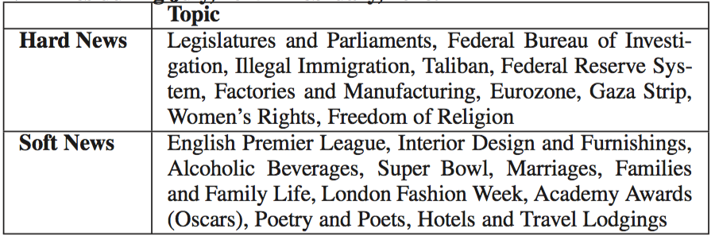
Examples of hard/soft news topics

Slide 25
Comparing recommendations
differing on source
Recommendations from experts vs. crowds

Slide 26
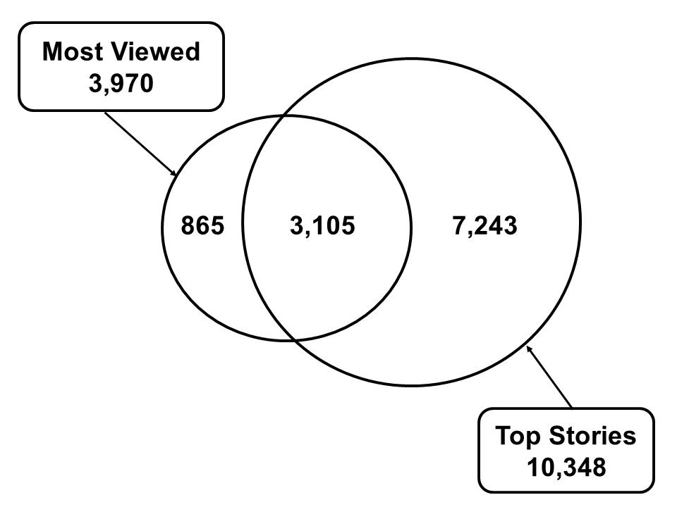
Differences in individual news stories
22% of most viewed stories are exclusively picked by the crowds.

Slide 27
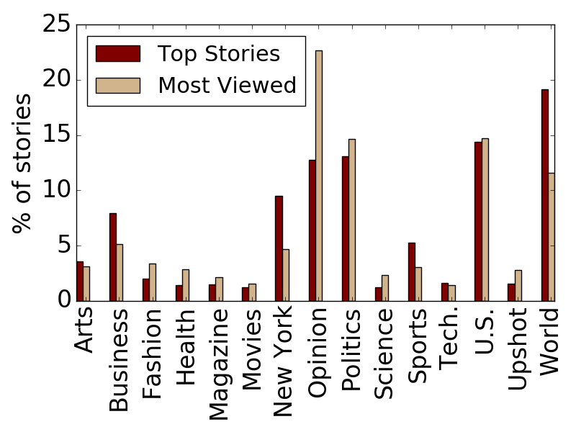
Differences in sectional coverage

Slide 28
Take Away
Sections of broad interest World, Sports and Business are more recommended by experts.
Stories on niche interest like Health, Fashion, Science, and Opinion are recommended more by crowds.
Crowds recommend such stories more that are uniquely found on NYTimes than the stories that can also be found on other media websites.

Slide 29
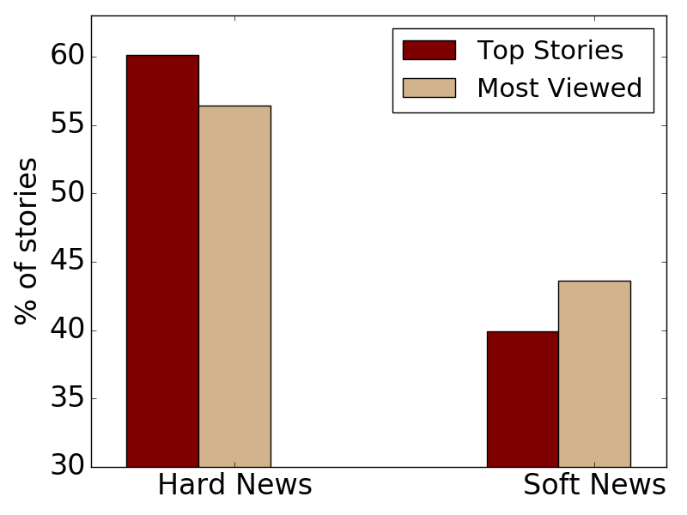
Differences in hard/soft news coverage
Experts recommend more hard news than crowds

Slide 30
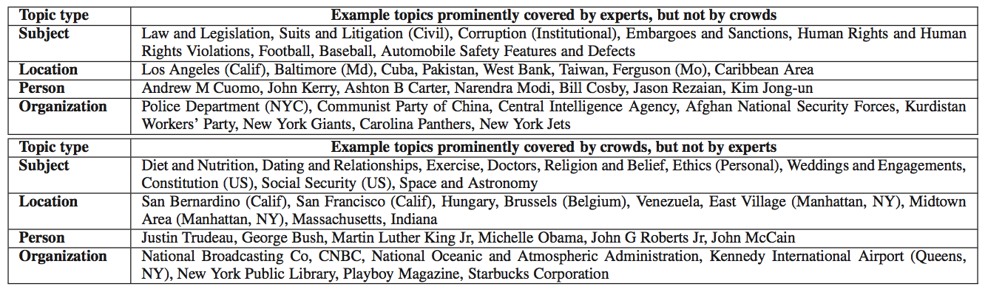
Differences in topical coverage
Experts prominently cover more hard news topics
Crowds prominently cover more soft news topics

Slide 31
Comparing recommendations
differing on source
Recommendations from crowds in different social media

Slide 32
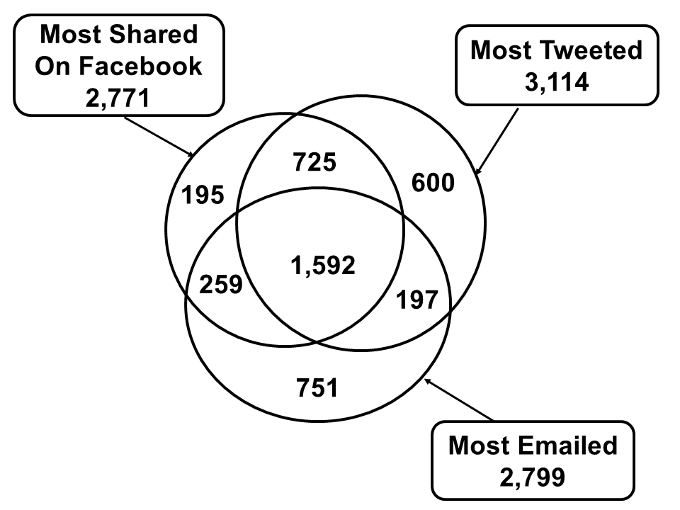
Differences in individual news stories
Significant non-overlap.
One would miss 26% most tweeted stories even after reading all stories most shared on Facebook.

Slide 33
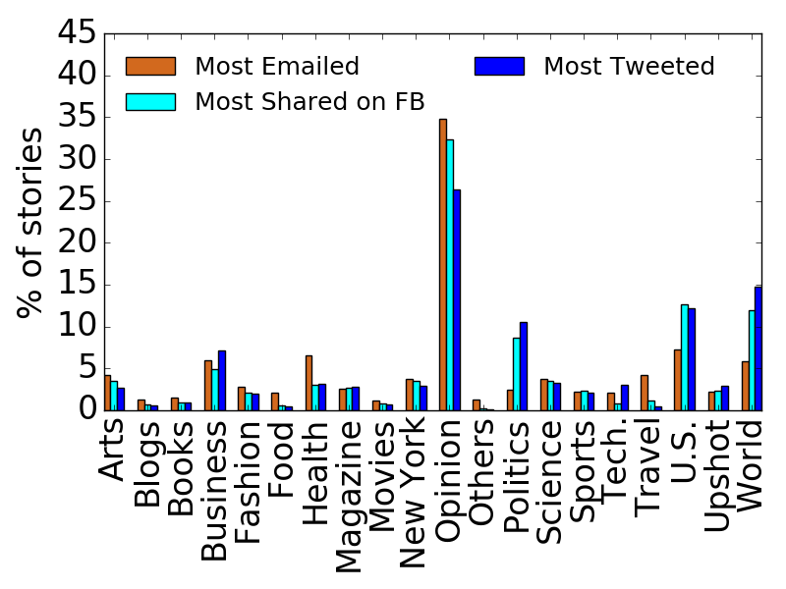
Differences in sectional coverage

Slide 34
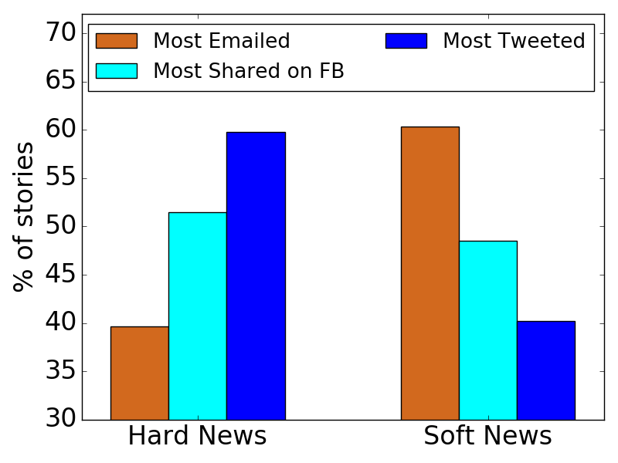
Differences in hard/soft news coverage

Slide 35
Take Away
Differences in the personal nature of various social media channels.
Email (mostly one-to-one communication) is more personal than Facebook (mostly conversations with reciprocal friends) which in turn is more personal than Twitter (one-to-many followers communication).
As the medium becomes more personal, less of hard news and more of soft news stories are shared.

Slide 36
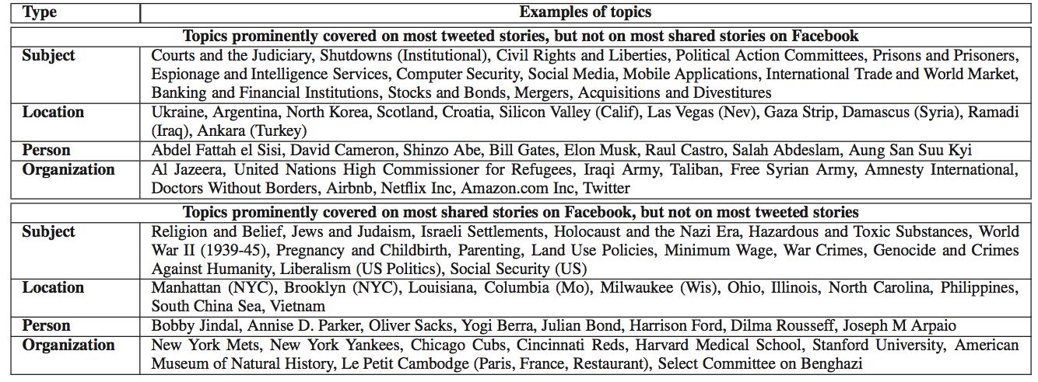
Differences in topical coverage

Slide 37
Take Away
People share hard news topics more prominently on Twitter, soft news on email, and a mix of both on Facebook.
Locations covered on Twitter are mostly international, whereas locations on Facebook and email are more national and local.
Persons covered on Twitter are mostly premiers of different countries, or business tycoons.
Persons covered on Facebook or email are U.S. politicians, movie actors, or sports stars.

Slide 38
Comparing recommendations
over time-scales

Slide 39
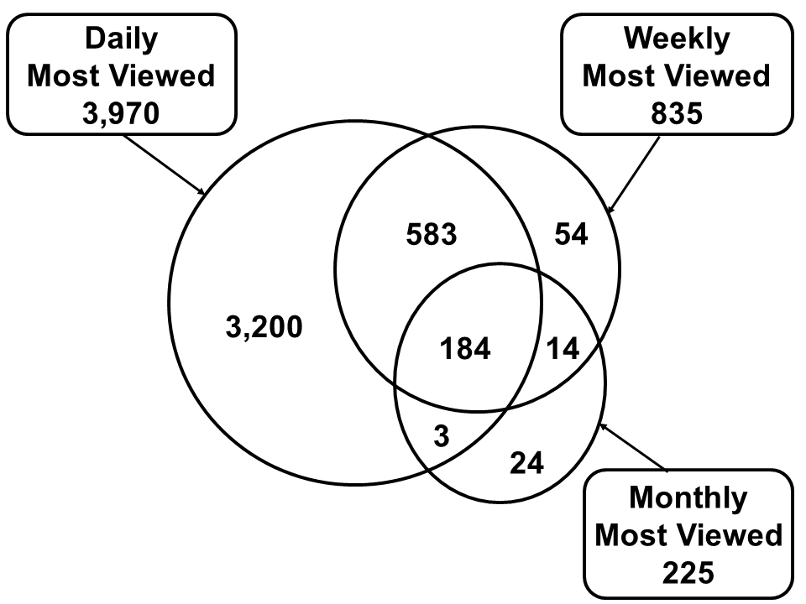
Differences in individual news stories
Even after reading most viewed
stories every day during a month, one will miss 17% of the most viewed stories over that month.

Slide 40
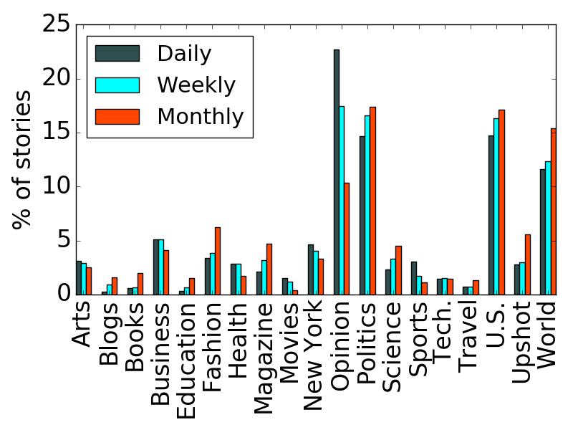
Differences in sectional coverage

Slide 41
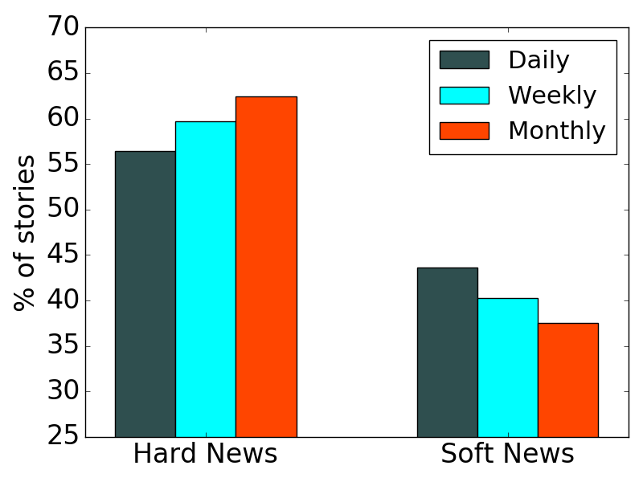
Differences in hard/soft news coverage
Recommendation over long term cover more hard news and less soft news.

Slide 42
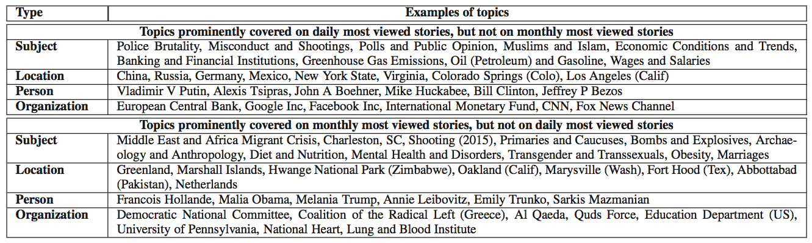
Differences in topical coverage

Slide 43
Summary
Orthogonal views of same news media can be created by different recommendations filter news.
Recommendations today are imperative where design choices are made using rules of thumb.
Future recommendations should be declarative with a particular goal and required constraints.

Slide 44
Stop Clickbait: Detecting & Preventing Clickbaits in Online News Media
Niloy Ganguly
joint work with
Abhijnan Chakraborty, Bhargavi Paranjape, and Sourya Kakarla
ASONAM 2016 (Best Student Paper Award)

Slide 45
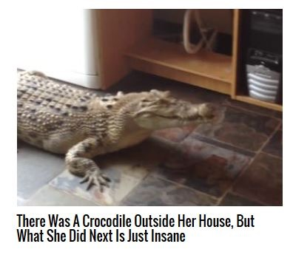
You’ll Get Chills When You See These Examples of Clickbait
Notes:
You all have come across many such headlines in your social media newsfeed, which have compelled you to click the link to read the article. Diversity in topics covered.

Slide 46
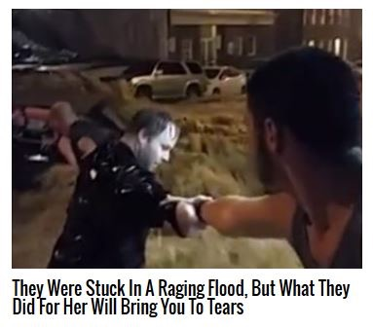
You’ll Get Chills When You See These Examples of Clickbait

Slide 47
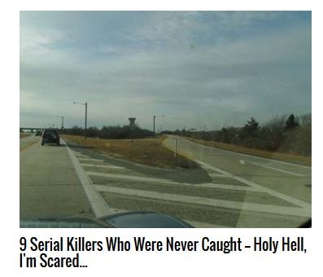
You’ll Get Chills When You See These Examples of Clickbait

Slide 48
What is Clickbait?
(On the Internet) content whose main purpose is to attract attention and encourage visitors to click on a link to a particular web page. - Oxford English Dictionary
Exploit Curiosity Gap:
Headlines provide forward referencing cues to generate painful information gap.
Readers feel compelled to click on the link to fill the gap, and ease the pain.
The Psychology of Curiosity, George Loewenstein, 1994
Notes:
Loewenstein outlines five curiosity triggers that alert people to such a gap: questions or riddles, unknown resolutions, violated expectations, access to information known by others, and reminders of something forgotten.

Slide 49
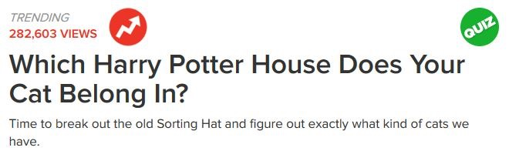
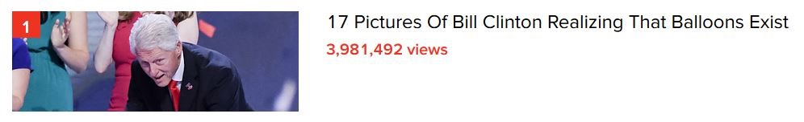
Good: Increased Viewership

Slide 50
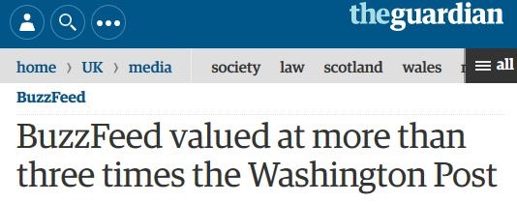
Good: Skyrocketing Valuations
Notes:
10 year old buzzfeed, 139 years old Washington Post

Slide 51
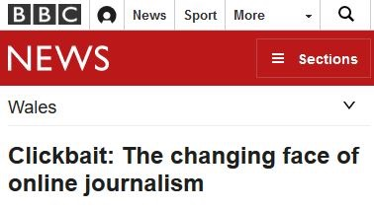
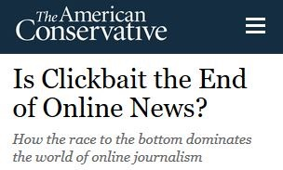
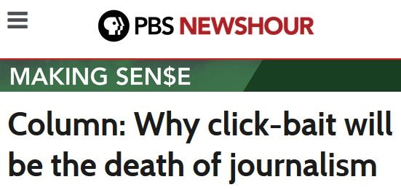
Bad: RIP Journalistic Gatekeeping

Slide 52
Goal of This Work
Bring in more transparency and
offer readers choice to deal with clickbaits

Slide 53
Workplan
Given an article headline on a webpage, or on social media sites, detect the headline as clickbait, and warn the reader.
Depending on reader choices, automatically block certain clickbait headlines from appearing on websites during her future visits.
Notes:
Motivate : dissaudes you from reading articles that may have a moderately attractive headline but maybe very informative
Problem that even Facebook is trying to comabt

Slide 54
How to Detect Clickbaits?
Using fixed rules/matching common patterns: 74% accuracy
URL/Domain name matching: not all stories of a domain are clickbaits (e.g., Buzzfeed news).
To identify features, need to compare clickbaits with traditional news headlines.
Detecting clickbaits is non-trivial!

Slide 55
Dataset
Clickbait
Collected 8,069 articles from BuzzFeed, Upworthy, ViralNova, Thatscoop, Scoopwhoop.
7,623 articles were annotated by volunteers as clickbaits.
Non-clickbait
Collected 18,513 articles from Wikinews.
Community verified news content.
Fixed guidelines to write headlines, rigorously checked.
Took 7,500 articles from each category for comparison.
Notes:
Annotation results, gold standards, why wikinews, why not annotate news data (annotation expensive)

Slide 56
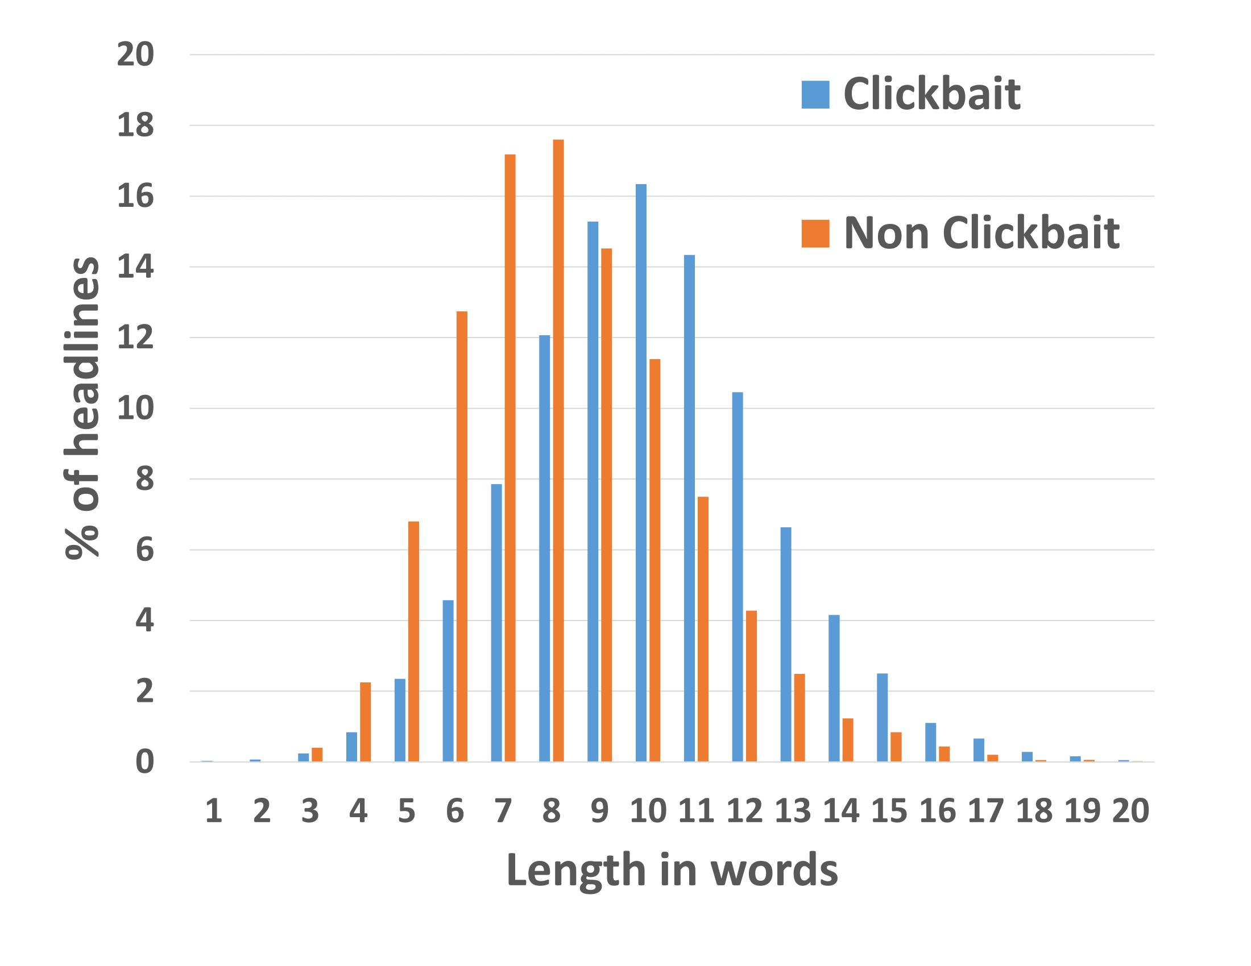
What makes clickbaits different?
Length: Clickbaits are well formed English sentences that include both content and function words.
Unusual Punctuation Patterns: Often ends with !?, ..., ***, !!!
Use of Stop Words: Disproportionate occurrence in clickbaits
Number of words in headline
Notes:
Be ready with example

Slide 57
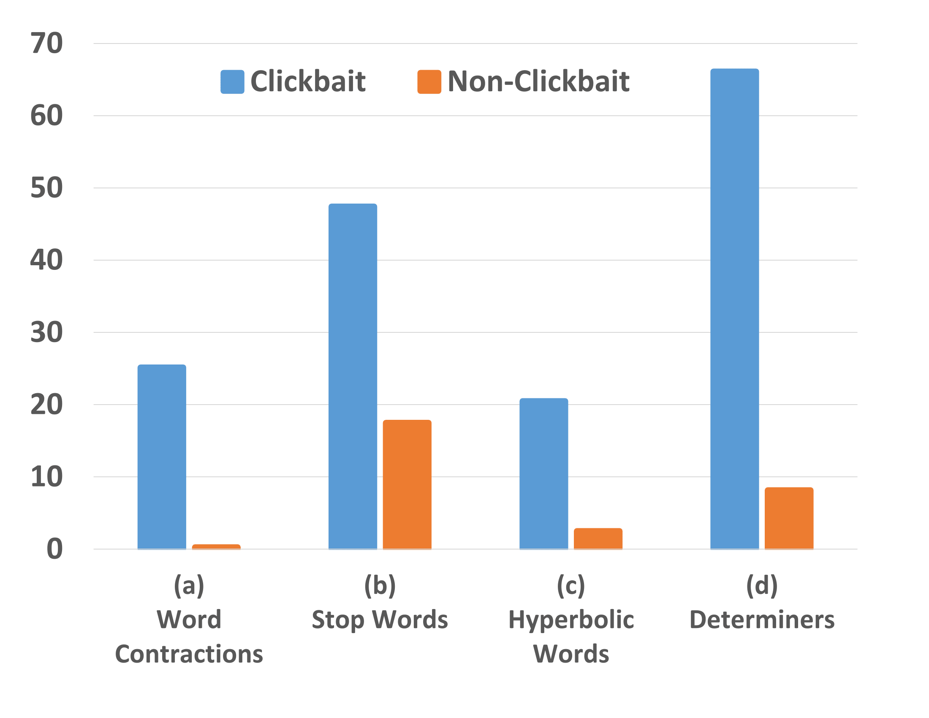
What makes clickbaits different?
Word Contractions: they’re, you’re, you’ll, we’d
Words with very positive sentiment (Hyperbolic words): Awe-inspiring, breathtakingly, gut-wrenching, soul-stirring
Determiners (forward reference particular people or things in the article): their, this, what, which
% of headlines
Notes:
Where did they come from in classifier

Slide 58
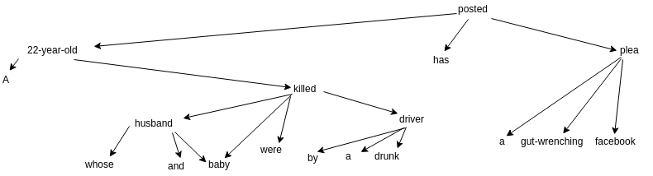
What makes clickbaits different?
Long Syntactic Dependencies between governing and dependent words:
Due to existence of complex phrasal sentences.
Length between subject ‘22-Year-Old’ and verb ‘Posted’ is 11 in
A 22-Year-Old Whose Husband And Baby Were Killed By A Drunk Driver Has Posted A Gut-Wrenching Facebook Plea
Notes:
N-grams do they have stop words : is this wrong

Slide 59
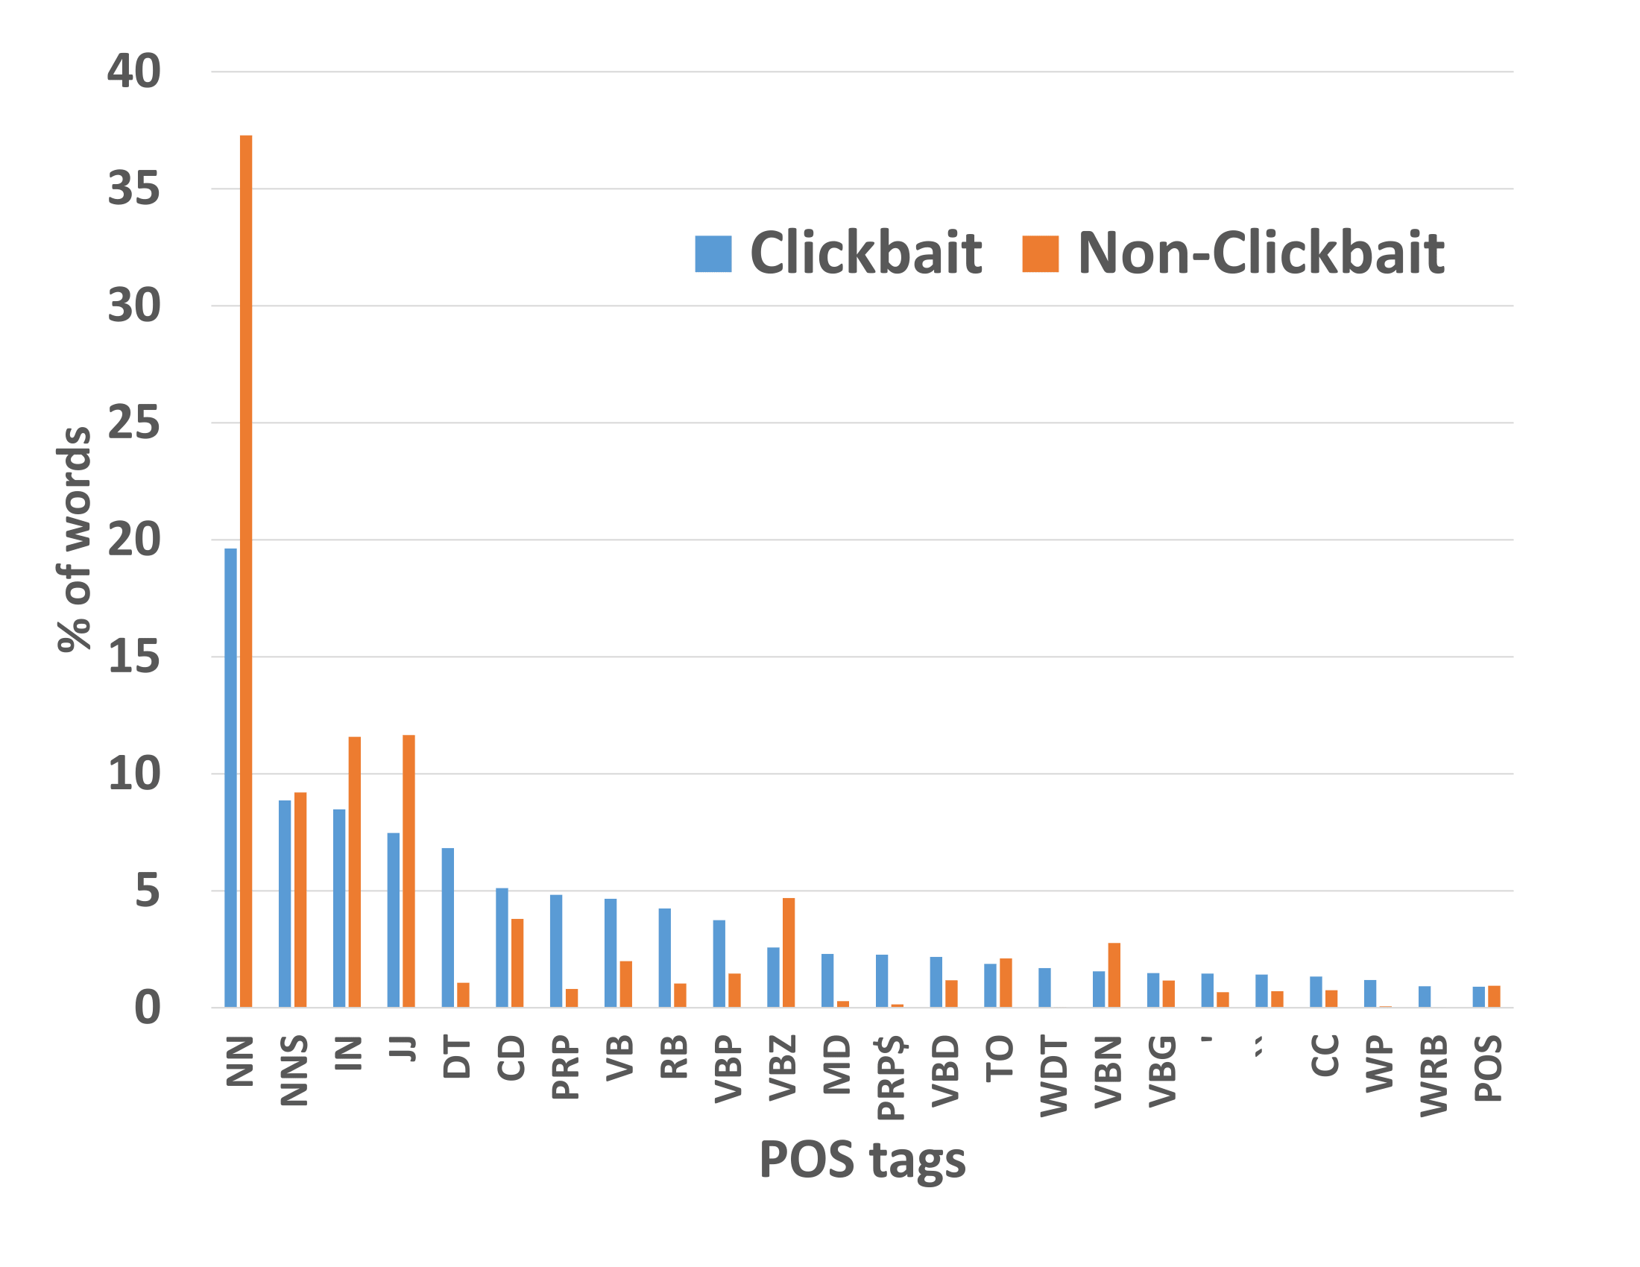
What makes clickbaits different?
Distribution of POS tags
Non-clickbaits: More proper nouns (NN), verbs in past participle and 3rd person singular form (VBN, VBZ).
Clickbaits: More adverbs and determiners (RB, DT, WDT), personal and possessive pronouns (PRP, PRP$), verbs in past tense and non-3rd person singular forms (VBD, VBP).

Slide 60
Classifying Headlines as Clickbaits
Classifier: SVM with RBF kernel
14 Features (detailed in the paper).
10-fold cross validation performance:
Accuracy | 93%
Precision | 0.95
Recall | 0.90
F1 Score | 0.93

Slide 61
Next task
Block clickbaits from appearing on different websites

Slide 62
What Interests You, Annoys Me
12 regular news readers reviewed 200 random clickbait headlines.
Marked clickbaits they would click or block.
Average Jaccard coefficients for clicked as well as blocked clickbaits are low across readers.
Signals high heterogeneity in reader choices.
Reimagine Blocking as Personalized Classification!

Slide 63
Modeling Reader’s Interests
Model the reader’s interests from the articles she has already clicked as well as already blocked.
Two possible interpretations of reader interests in Clickbait (or lack thereof)
For the following clickbait:
Can You Guess The Hogwarts House of These Harry Potter Characters?
The reader likes/dislikes Harry Potter or the fantasy genre
She likes/gets annoyed by the pattern, “Can You Guess ….. ’’

Slide 64
Blocking Based on Topical Similarity
Extract content words from headline, article metatags and keywords that occur in the html <head>: tagset
Use BabelNet: multilingual semantic network which connects 14 million concepts and named entities.
Interest Expansion: Common hypernym neighbours of tags in tagset form a cluster (nugget). Two nuggets merge when nodes occur commonly in them.
Form reader’s BlockNuggets and ClickNuggets.
Blocking decision on Query Tagset: How many nodes are common with BlockNuggets or ClickNuggets.
Notes:
Add how the classification (+ve and -ve) block and click works for a baseline
Large sematic

Slide 65
Blocking Based on Patterns
1. Normalization of headlines
Numbers and Quotes are replaced by tags < D > and < QUOTE >
200 most common words + English stop words retained.
Nouns, Adjectives, Adverbs and Verb inflections replaced by POS tags.
“Which Dead ‘Grey’s Anatomy’ Character Are You”
“which JJ < QUOTE > character are you”
“Which ‘Inside Amy Schumer’ Character Are You”
“which < QUOTE > character are you”
2. Set of patterns for both blocked and clicked articles.
3. Blocking decision on Query: Average word level Edit Distances from blocked and clicked articles.
Notes:
How was the survey conducted

Slide 66
Performance of Blocking Approaches
12 readers were shown 200 clickbait articles.
Their blocks and clicks recorded.
3:1 train:test split with 4 fold cross validation.
Pattern based approach performs best.
Approach | Accuracy | Precision | Recall | F1 Score
Pattern Based | 0.81 | 0.834 | 0.76 | 0.79
Topic Based | 0.75 | 0.769 | 0.72 | 0.74
Hybrid | 0.72 | 0.766 | 0.682 | 0.72

Slide 67
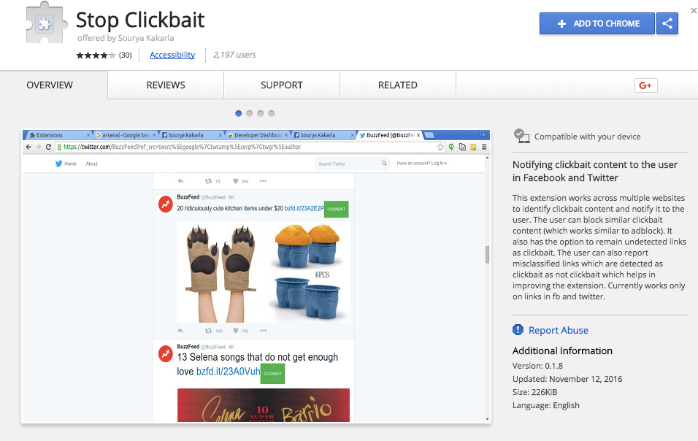
Browser Extension: Stop Clickbait
Notes:
Made it available on the chrome store
https://chrome.google.com/webstore/detail/stopclickbait/iffolfpdcmehbghbamkgobjjdeejinma

Slide 68
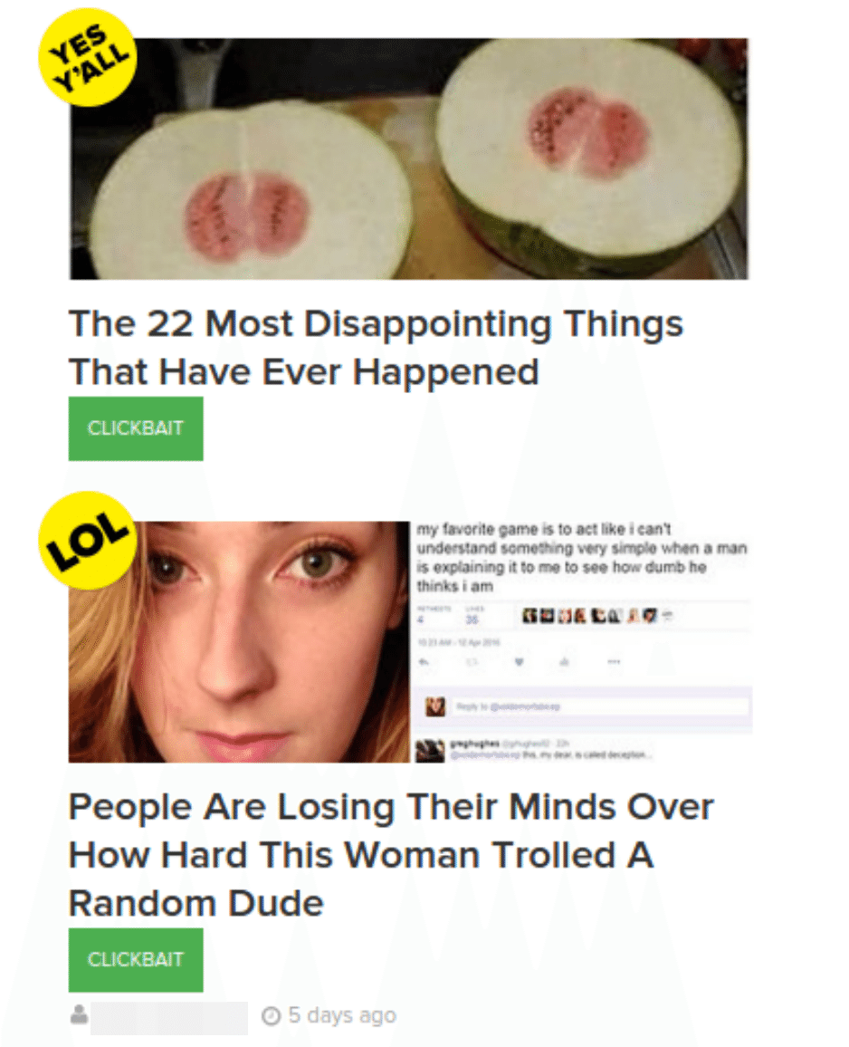
Notify Clickbaits
Notes:
Search, paper currently under review in ASONAM

Slide 69
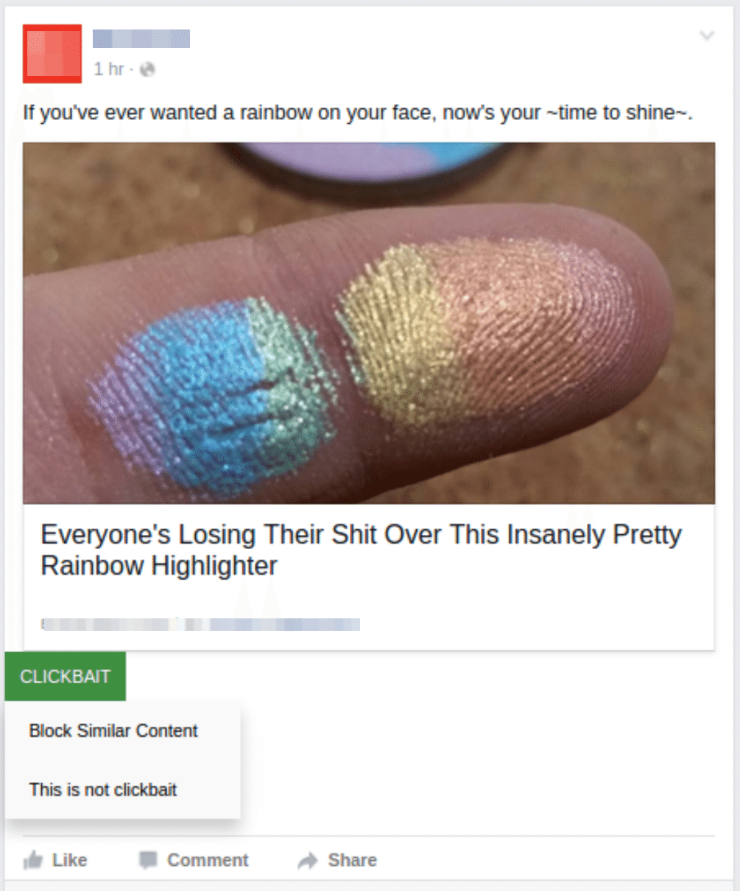
Block or Report Wrong Label

Slide 70
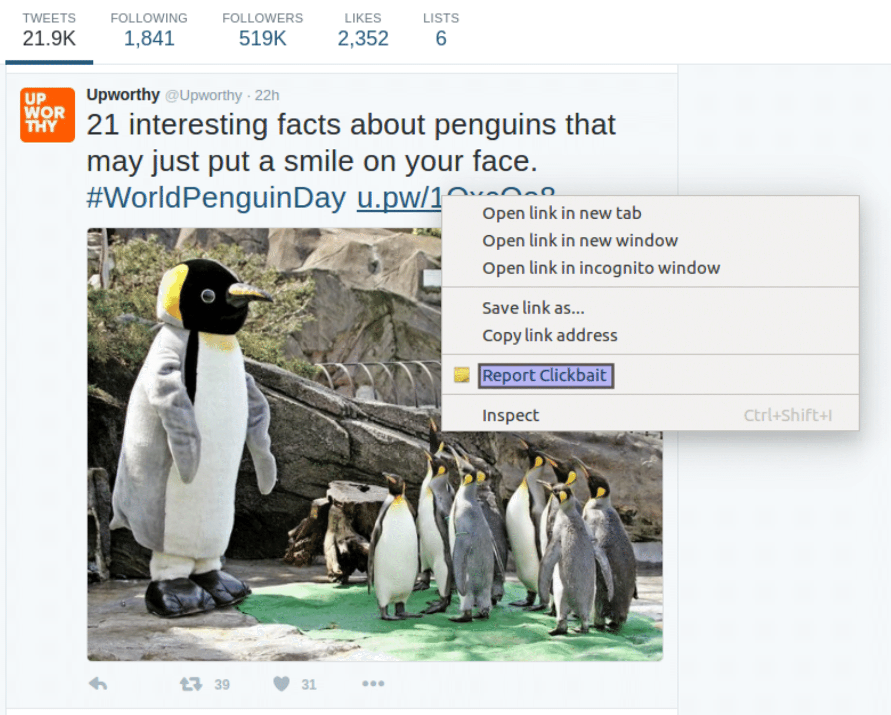
Report Missed Clickbaits
Notes:
Search, paper currently under review in ASONAM

Slide 71

Who Makes Trends? Understanding Demographic Biases in Crowdsourced Recommendations
Niloy Ganguly
joint work with
Abhijnan Chakraborty, Johnnatan Messias, Fabricio Benevenuto,
Saptarshi Ghosh, and Krishna P. Gummadi
ICWSM 2017

Slide 72
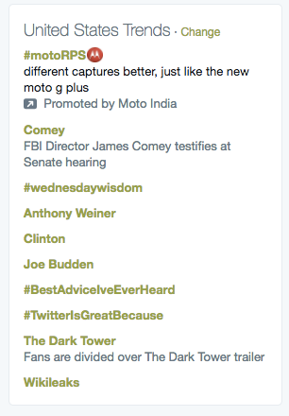
Twitter trending topics
Example of crowdsourced recommendations
Topics which exhibit highest spike in recent usage by Twitter crowd

Slide 73
Past works on trends
What are the trends?
Naaman et al., JASIST 2011

Slide 74
Past works on trends
What are the trends?
Politics

Slide 75
Past works on trends
What are the trends?
Entertainment

Slide 76
Past works on trends
How are the trends selected?
Mathioudakis et al., SIGMOD 2010

Slide 77
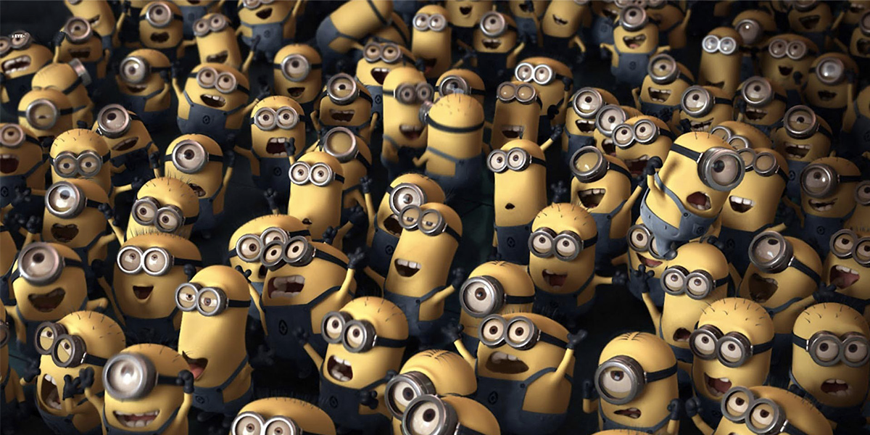
Focus of this work
Who are the people behind these trends?

Slide 78
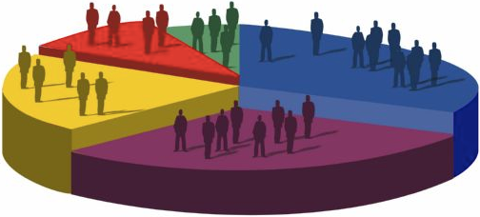
Focus of this work
Analyze the demographics of crowds promoting Twitter trends

Slide 79
Who are the promoters of Twitter trends?
Promoters of a trend: who used a topic before it became trending.

Slide 80
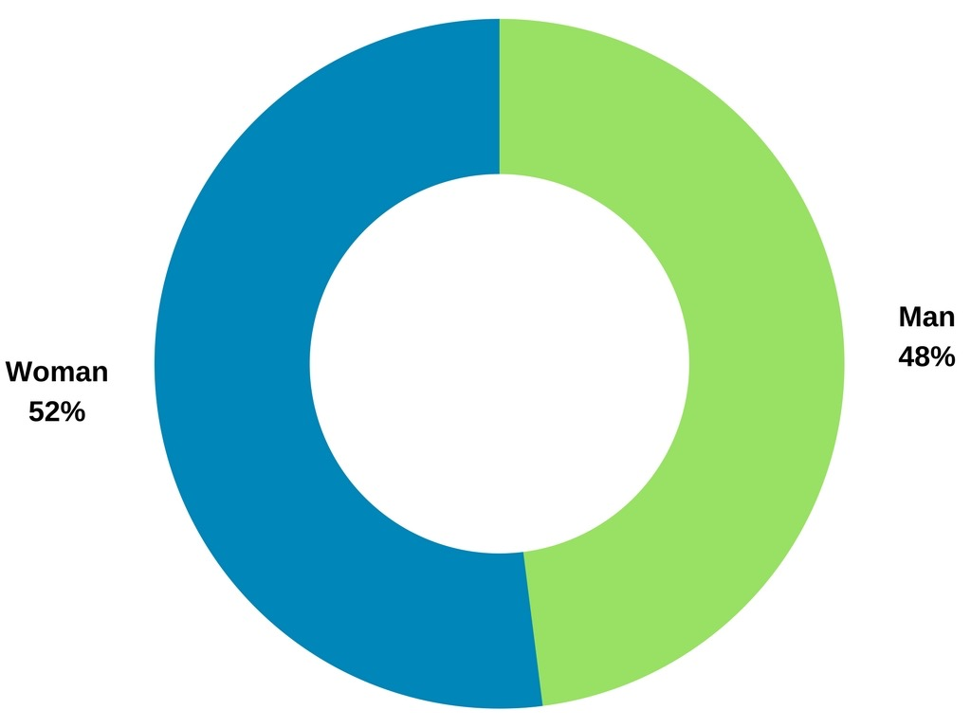
Who are the promoters of Twitter trends?

Slide 81

Who are the promoters of Twitter trends?

Slide 82

Who are the promoters of Twitter trends?

Slide 83

Who are the promoters of Twitter trends?

Slide 84
Research Questions
How different are the trend promoters from Twitter’s overall population?
Are certain socially salient groups under-represented among the promoters?
Do promoters and adopters of a trend have different demographics?
What can promoter demographics tell about the trend content?

Slide 85

Demographic attributes considered
Gender
Male/Female

Slide 86

Demographic attributes considered
Gender
Male/Female
Race
White/Black/Asian

Slide 87

Demographic attributes considered
Gender
Male/Female
Race
White/Black/Asian
Age
Adolescent (<20)
Young (20-40)
Mid-Aged (40-65)
Old (>65)

Slide 88


Key challenge
How to infer demographic attributes at scale?
From the screen name
From the profile description
From the profile image
Used Face++, a neural-network based face recognition tool.

Slide 89


Inferring demographics from profile images
Mid-Aged, White, Male
Young, Asian, Female

Slide 90
Inferring demographics from profile images
Also used in earlier works [Zagheni et al, WWW 2014; An and Weber, ICWSM 2016]
Face++ performs reasonably well
Gender inference accuracy: 88%
Racial inference accuracy: 79%
Age-group inference accuracy: 68%
Gathered demographic information of 1.7M+ Twitter users, covered by Twitter’s 1% random sample during July - September, 2016

Slide 91

Gender demographics of Twitter population in US

Slide 92

Racial demographics of Twitter population in US

Slide 93

Age demographics of Twitter population in US

Slide 94
Research Questions
How different are the trend promoters from Twitter’s overall population?
Are certain socially salient groups under-represented among the promoters?
Do promoters and adopters of a trend have different demographics?
What can promoter demographics tell about the trend content?

Slide 95

Gender demographics of trend promoters
Trend promoters have varied demographics
Men are represented more among promoters of 53% trends
Twitter population in US

Slide 96

Racial demographics of trend promoters
Similar pattern considering racial demographics
Whites are represented more among promoters of 65% trends
Twitter population in US

Slide 97
Trend promoters differing significantly
from overall population
Demographic attribute | % of trends
Gender | 61.23 %
Race | 80.19 %
Age | 76.54 %
Where difference between the demographics of promoter and overall population is statistically significant.

Slide 98
Research Questions
How different are the trend promoters from Twitter’s overall population?
Are certain socially salient groups under-represented among the promoters?
Do promoters and adopters of a trend have different demographics?
What can promoter demographics tell about the trend content?

Slide 99
Under-representation of socially salient groups
A demographic group is under-represented when its fraction among promoters is < 80% of that in overall population
Motivated by the 80% rule used by U.S. Equal Employment Opportunity Commission

Slide 100

Under-representation of socially salient groups
Women, Blacks and Mid-aged people are under-represented most.

Slide 101

Under-representation of socially salient groups
Considering race and gender together,
Black women are most under-represented.

Slide 102
Research Questions
How different are the trend promoters from Twitter’s overall population?
Are certain socially salient groups under-represented among the promoters?
Do promoters and adopters of a trend have different demographics?
What can promoter demographics tell about the trend content?

Slide 103

Importance of being trending
Topics get adopted by wider population after becoming trending

Slide 104
Research Questions
How different are the trend promoters from Twitter’s overall population?
Are certain socially salient groups under-represented among the promoters?
Do promoters and adopters of a trend have different demographics?
What can promoter demographics tell about the trend content?

Slide 105
Promoters and Trends
Trends express niche interest of the promoter groups.
Trends represent different perspectives during different events.

Slide 106

Trends expressing niche interest
Promoters of #BlackWomenAtWork
Overall population

Slide 107


Trends expressing different perspectives
During Dallas Shooting (7th and 8th July, 2016)
Promoters of #BlackLivesMatter
Promoters of #PoliceLivesMatter

Slide 108
Need to know the promoters to understand the context for trends

Slide 109

Demo
Who-Makes-Trends: A public web service
http://twitter-app.mpi-sws.org/who-makes-trends

Slide 110

Who-Makes-Trends: Search Trends by Date
http://twitter-app.mpi-sws.org/who-makes-trends

Slide 111

Who-Makes-Trends: Search Trends by Date
http://twitter-app.mpi-sws.org/who-makes-trends

Slide 112

Who-Makes-Trends
#dubnation: used by fans of Golden State Warriors,
Basketball Team based in Oakland, California
http://twitter-app.mpi-sws.org/who-makes-trends

Slide 113

Who-Makes-Trends
#dubnation: used by fans of Golden State Warriors,
Basketball Team based in Oakland, California
http://twitter-app.mpi-sws.org/who-makes-trends

Slide 114

Who-Makes-Trends
#dubnation: used by fans of Golden State Warriors,
Basketball Team based in Oakland, California
http://twitter-app.mpi-sws.org/who-makes-trends

Slide 115

Who-Makes-Trends: Search Trends by Text
http://twitter-app.mpi-sws.org/who-makes-trends

Slide 116
Who-Makes-Trends
http://twitter-app.mpi-sws.org/who-makes-trends

Slide 117

Complex Network Research Group (CNeRG) IIT Kharagpur
http://cnerg.org @cnerg
facebook.com/iitkgpcnerg/

Slide 118
Optimizing the Recency-Relevancy Trade-off in Online News Recommendations
Abhijnan Chakraborty, Saptarshi Ghosh,
Niloy Ganguly, Krishna P. Gummadi
www’2017

Slide 119

Background: News Recommendations
Traditionally news editors used to manually select important storie
180 - 200 news stories printed in New York Times daily paper
15 - 20 stories on the front page

Slide 120
Background: News Recommendations
News organizations today produce way more stories onlin
750 - 800 news stories added every day to nytimes.com
Recommendations need to be updated 24/7

Slide 121

Background: News Recommendations
News organizations today produce way more stories onlin
750 - 800 news stories added every day to nytimes.com
Recommendations need to be updated 24/7
7 PM

Slide 122

Background: News Recommendations
News organizations today produce way more stories onlin
750 - 800 news stories added every day to nytimes.com
Recommendations need to be updated 24/7
8 PM

Slide 123

Background: News Recommendations
News organizations today produce way more stories onlin
750 - 800 news stories added every day to nytimes.com
Recommendations need to be updated 24/7
9 PM

Slide 124
Background: News Recommendations
News organizations today produce way more stories onlin
750 - 800 news stories added every day to nytimes.com
Recommendations need to be updated 24/7
Hard to manage manually using only human editors.
Need automated methods for Frontpage news recommendations

Slide 125
Desired Properties of Recommended News
Recency: Recommended stories should be fresh.
Relevancy: Stories should be relevant.

Slide 126

Relevancy in Non-Personalized Recommendations
Stories recommended to readers who are not logged in.

Slide 127
Relevancy in Non-Personalized Recommendations
Stories recommended to readers who are not logged in.
Relevancy is the impact of a story estimated through its popularity among crowd.
Number of people who read or shared a story.

Slide 128

Impact of News Story
Impact of a News Story
#views
Time
t_{birth}
t_{death}

Slide 129
Impact of News Story
Impact of a News Story
#views
Time
t_{birth}
t_{death}
Lifetime

Slide 130
Impact of News Story
#views received in lifetime
(Relevancy)
#views
Time
t_{birth}
t_{death}
Lifetime

Slide 131
Recency-Relevancy Trade-off
Ideally, most relevant stories should be recommended soon after their publication.

Slide 132
Recency-Relevancy Trade-off
Ideally, most relevant stories should be recommended soon after their publication.
Hard to assess a story’s impact right after its publication.
Impact becomes evident as the story ages.
Confidence about impact
Time

Slide 133
Recency-Relevancy Trade-off
Ideally, most relevant stories should be recommended soon after their publication.
Hard to assess a story’s impact right after its publication.
Impact becomes evident as the story ages.
Confidence about impact
Recency
Time

Slide 134
Goal of this work:
Understand and optimize for the recency-relevancy trade-off in non-personalized news recommendations in online setting.

Slide 135
Categorizing Existing Recommendations
Latest Stories
Highest Recent-Impact Stories
Highest Rising-Impact Stories

Slide 136

Latest Stories
Recommend stories most recently published.
Maximizes recency but doesn’t take relevancy into account.

Slide 137

Highest Recent-Impact Stories
Recommend stories having highest popularity over a certain time duration ∆t immediately preceding recommendation time t’.
Recent Impact
#Views
Time
t’
∆t

Slide 138


Highest Recent-Impact Stories
Recommend stories having highest popularity over a certain time duration ∆t immediately preceding recommendation time t’.
Recent Impact
#Views
Time
t’
∆t

Slide 139

Highest Rising-Impact Stories
Recommend stories having highest rise in popularity during ∆t immediately preceding t’, compared to its earlier ∆t interval.
#Views
Time
t’
∆t

Slide 140

Highest Rising-Impact Stories
Recommend stories having highest rise in popularity during ∆t immediately preceding t’, compared to its earlier ∆t interval.
Twitter Trends
#Views
Time
t’
∆t

Slide 141

Highest Future-Impact Stories
Future-impact: How much user attention a story is likely to receive in the future (and not in the past).
Future-Impact
#Views
Time
t’

Slide 142
Effectivity of Future-Impact
Future-impact declines over time.
Maximum at birth to zero at death.
Effectively captures recency-relevancy trade-off.
Future-Impact
Recency
Time

Slide 143
Datasets Analyzed
Yahoo! News Dataset: User click information for 652 news stories from the ‘Today Module’ on Yahoo! homepage during two weeks of October, 2011.
CLEF NewsREEL Dataset: User click information for ~240K news stories from three German news domains: tagesspiegel.de, sport1.de, and gulli.com during July - August, 2014.
NYTimes Dataset: Retweets for ~11K NYTimes stories during March - April, 2016.

Slide 144
Comparing Recommendation Strategies
Performance on CLEF NewsREEL data

Slide 145
Comparing Recommendation Strategies
Performance on CLEF NewsREEL data

Slide 146
Comparing Recommendation Strategies
Performance on CLEF NewsREEL data

Slide 147
Comparing Recommendation Strategies
Performance on CLEF NewsREEL data

Slide 148
Comparing Recommendation Strategies
Strategy | Ranking on Recency | Ranking on Relevancy | Avg Ranking | Ranking on Future-Impact
Latest | 1 | 5 | 3 | 5
Highest Rising-Impact | 3 | 4 | 3.5 | 3
Highest Recent-Impact | 5 | 3 | 4 | 4
Highest Future-Impact predicted by OLS | 2 | 1 | 1.5 | 1
Highest Future-Impact predicted by GTB | 4 | 2 | 3 | 2
Even predicted future-impact outperforms others.
Prediction by OLS performs better than GTB.

Slide 149
Take-Away
Existing recommendations achieve sub-optimal trade-off between recency and relevancy.
The goal is to achieve a nice recency-relevancy trade-off.
Proposed a strategy which maximize a different metric: future-impact.
Optimizing future-impact optimizes both recency and relevancy.
Provided implementations using predicted future-impacts as well as accounting for prediction uncertainty.

Slide 150


Slide 151


Slide 152


Slide 153
Complex Network Research Group (CNeRG) IIT Kharagpur
http://cnerg.org @cnerg
facebook.com/iitkgpcnerg/

